Slide 1




.
CS 460 – Software Engineering for Mobile Devices
Dr. Adriano Cavalcanti
PhD MABE, MS EE, BSc CSc
Computational Nanotechnology & Biomed Robotics
Office location: Hebeler 107 - Phone 509-963-2063
Email: adriano.cavalcanti@cwu.edu
Office hours:
Mon Tue Wed 2:00pm-3:00pm; Or by appointment

Slide 2



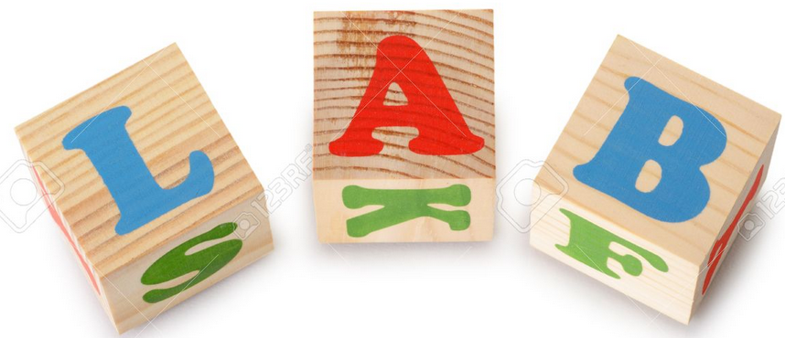








App Dev
Team of Two Students

Slide 3
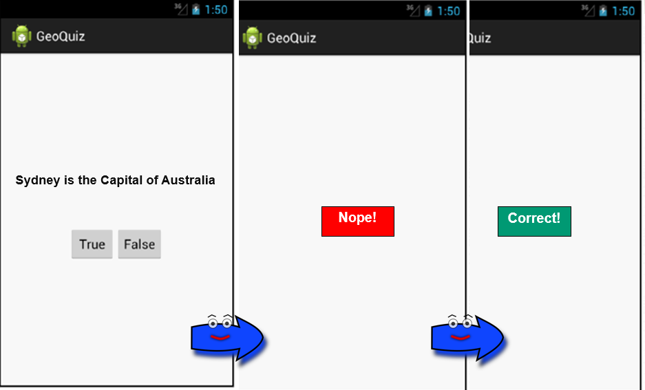
App Dev

Slide 4
App Dev
Develop an App with the following features:
Create the XML activities; (2 points)
Add the new keys to be associated with the GUI components; (1 point)
Create the Java activities; (2 points)
Activate the onClick event listener to trigger the App reaction to the user input. (1 point)
Use Intent to make the communication between Java and XML codes. (2 points)
The App should behave giving the output as depicted/exemplified in the previous page. (2 points)

